Slide 1
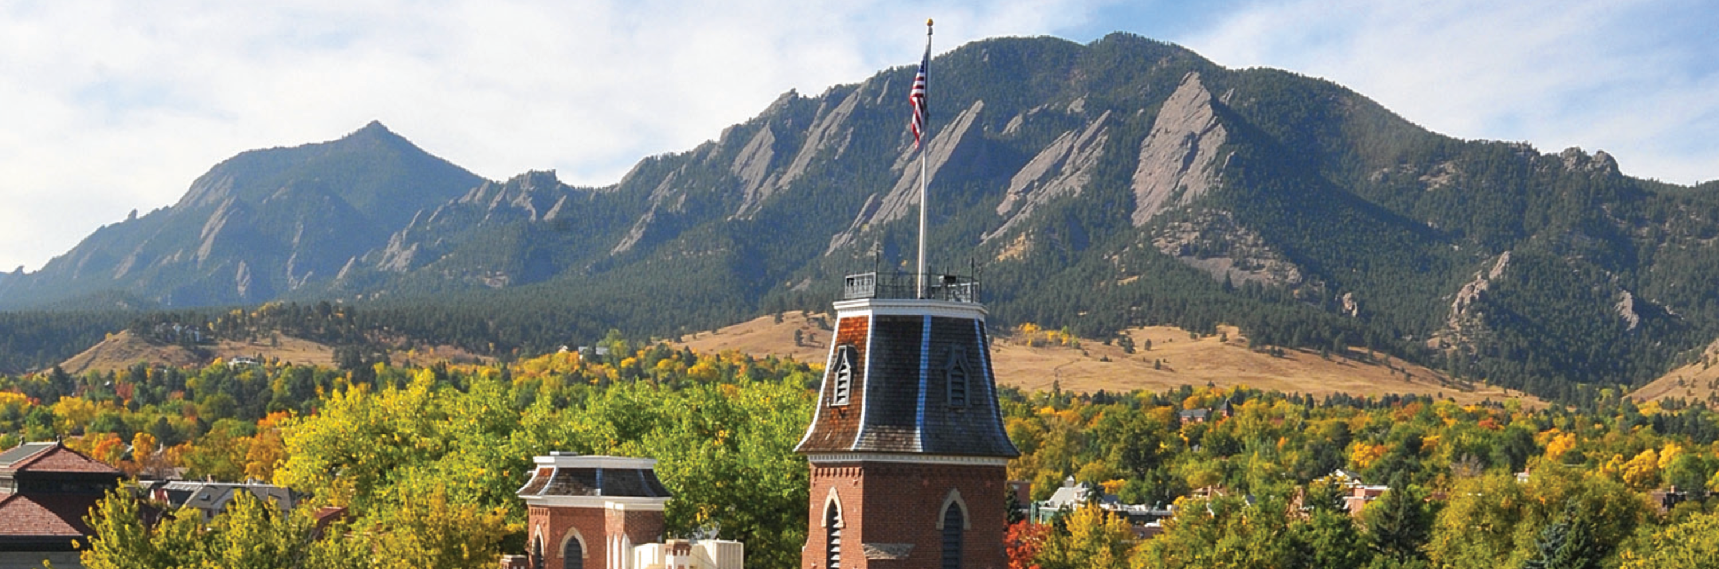
Setting up LLMs on CURC Resources

Slide 2
Setting up LLMs on CURC Resources
Instructor: Brandon Reyes
Research Computing
Website: www.rc.colorado.edu
Documentation: https://curc.readthedocs.io
Helpdesk: rc-help@colorado.edu
Survey: http://tinyurl.com/curc-survey18

Slide 3
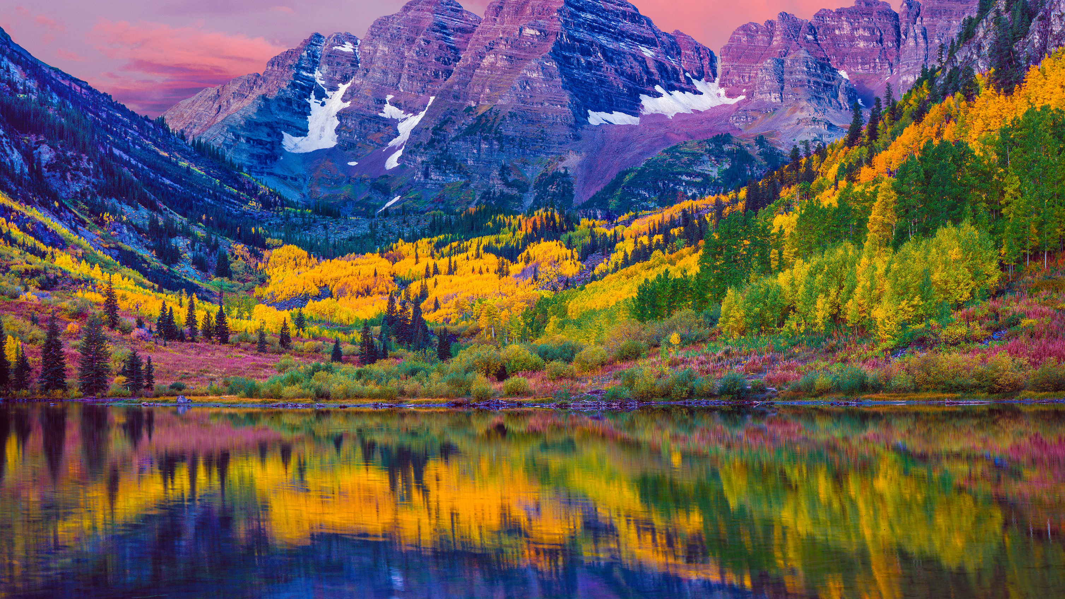

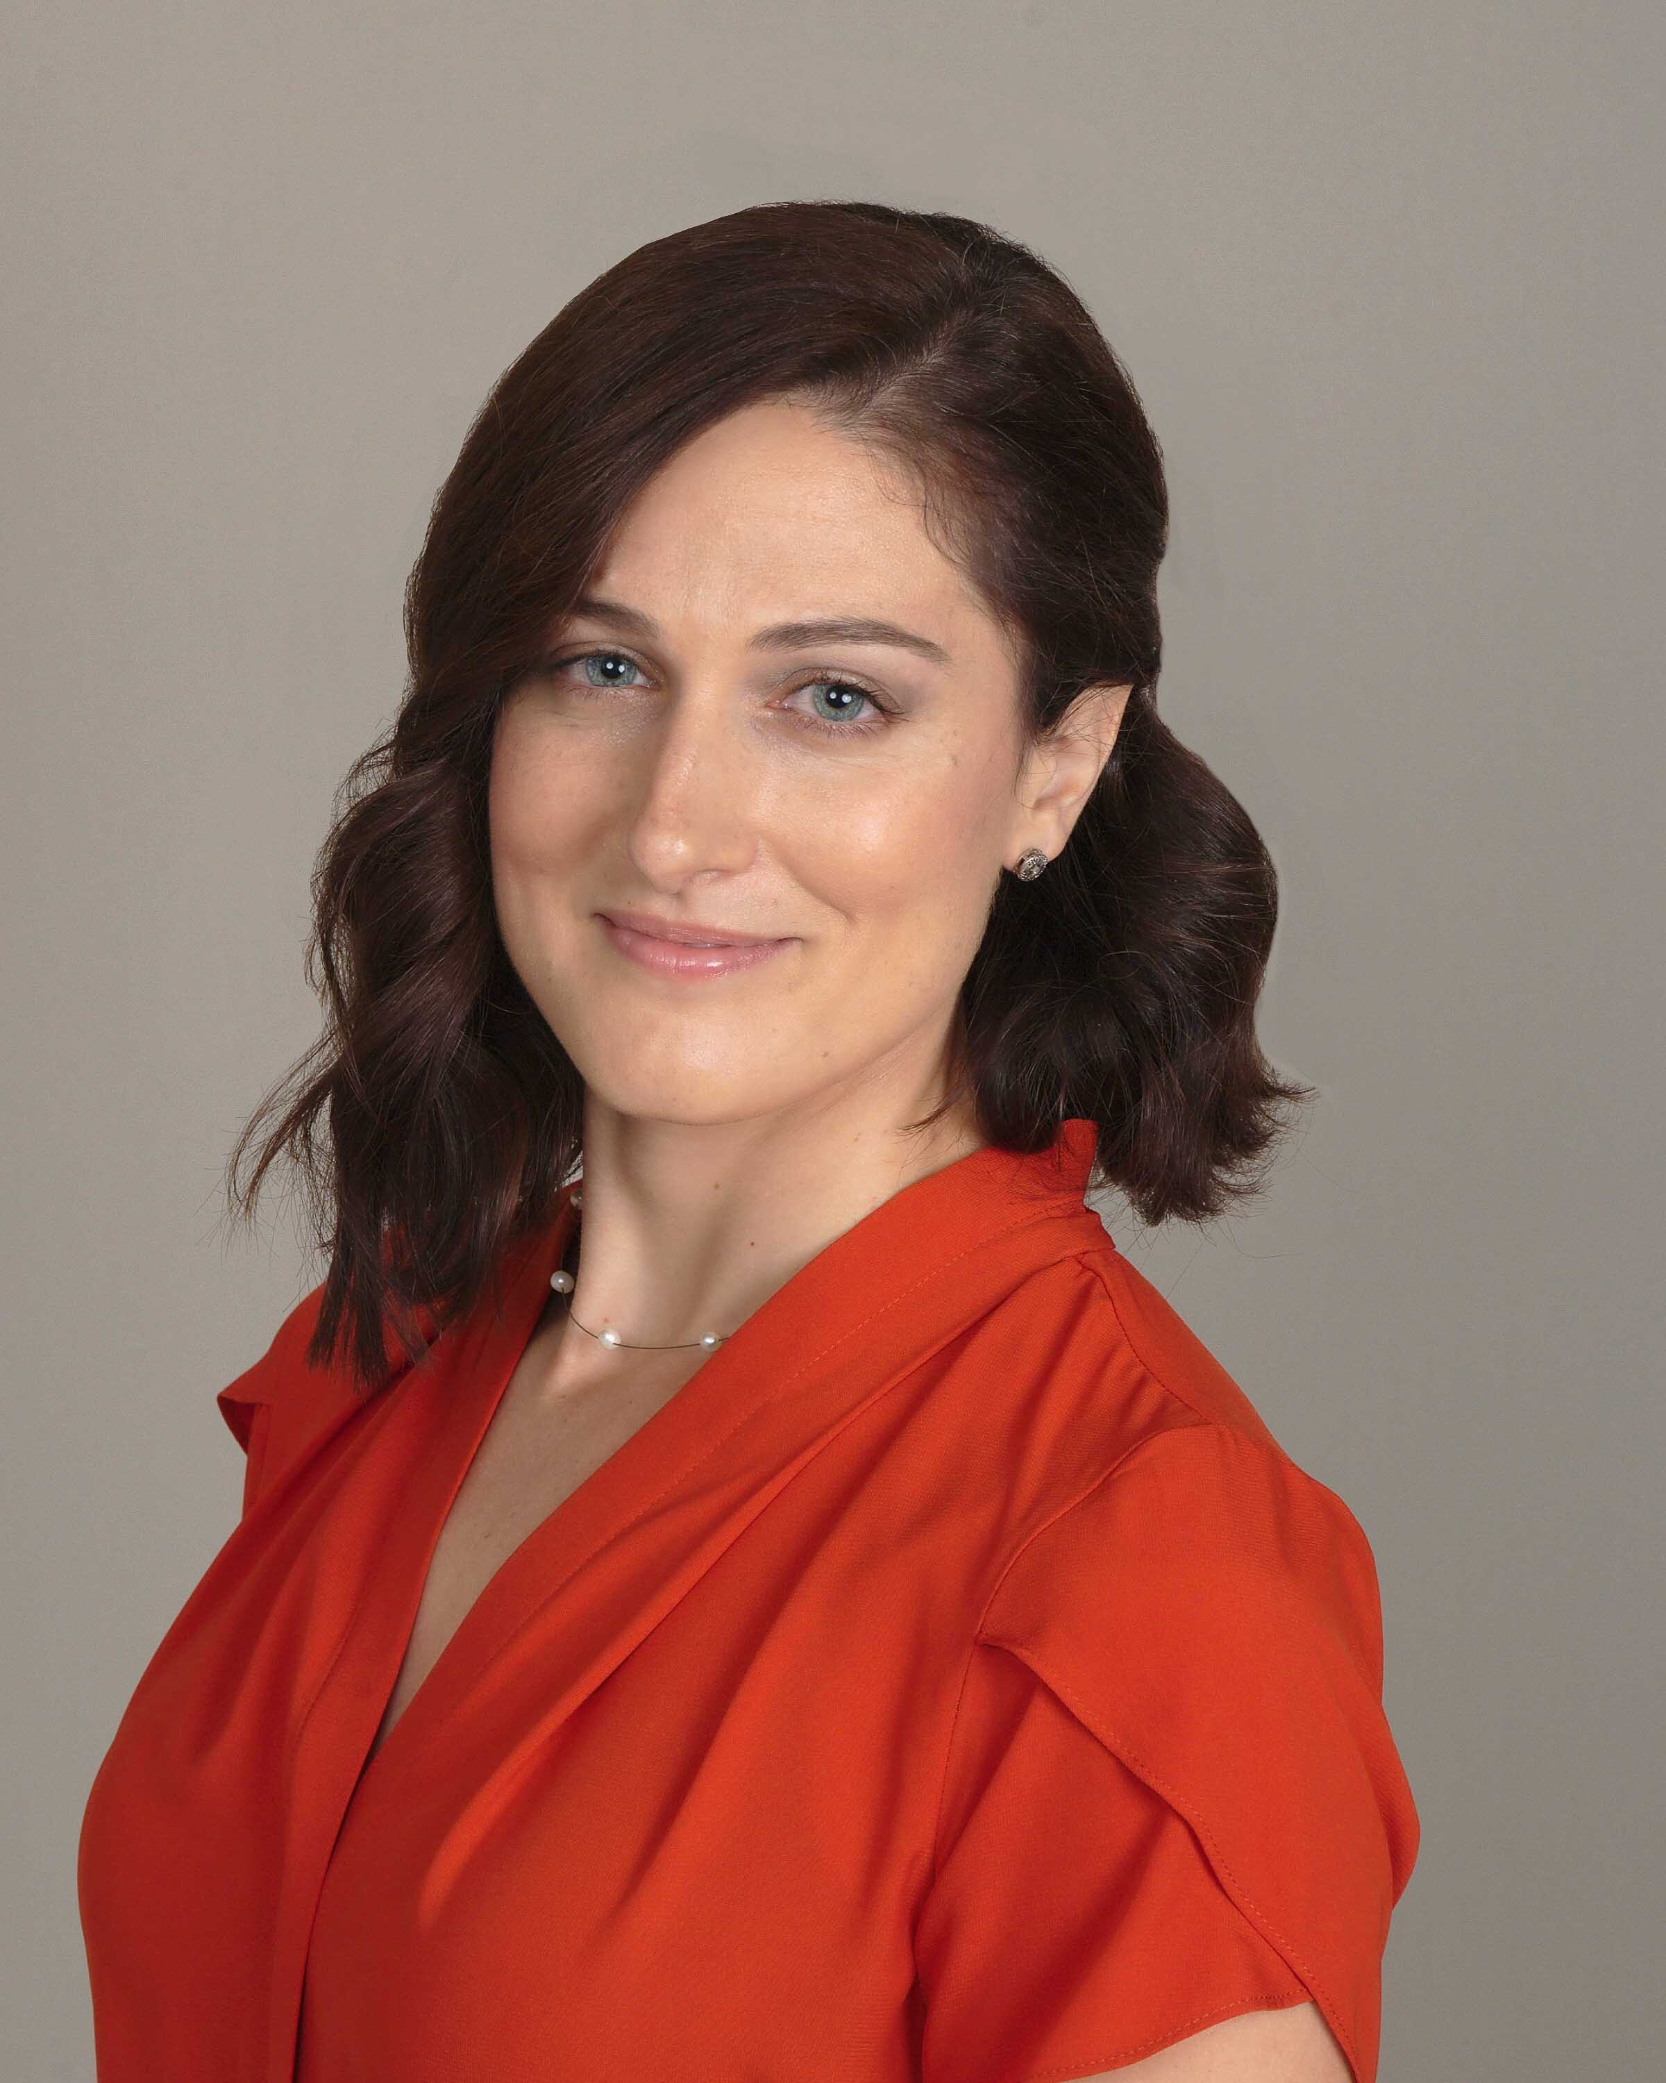
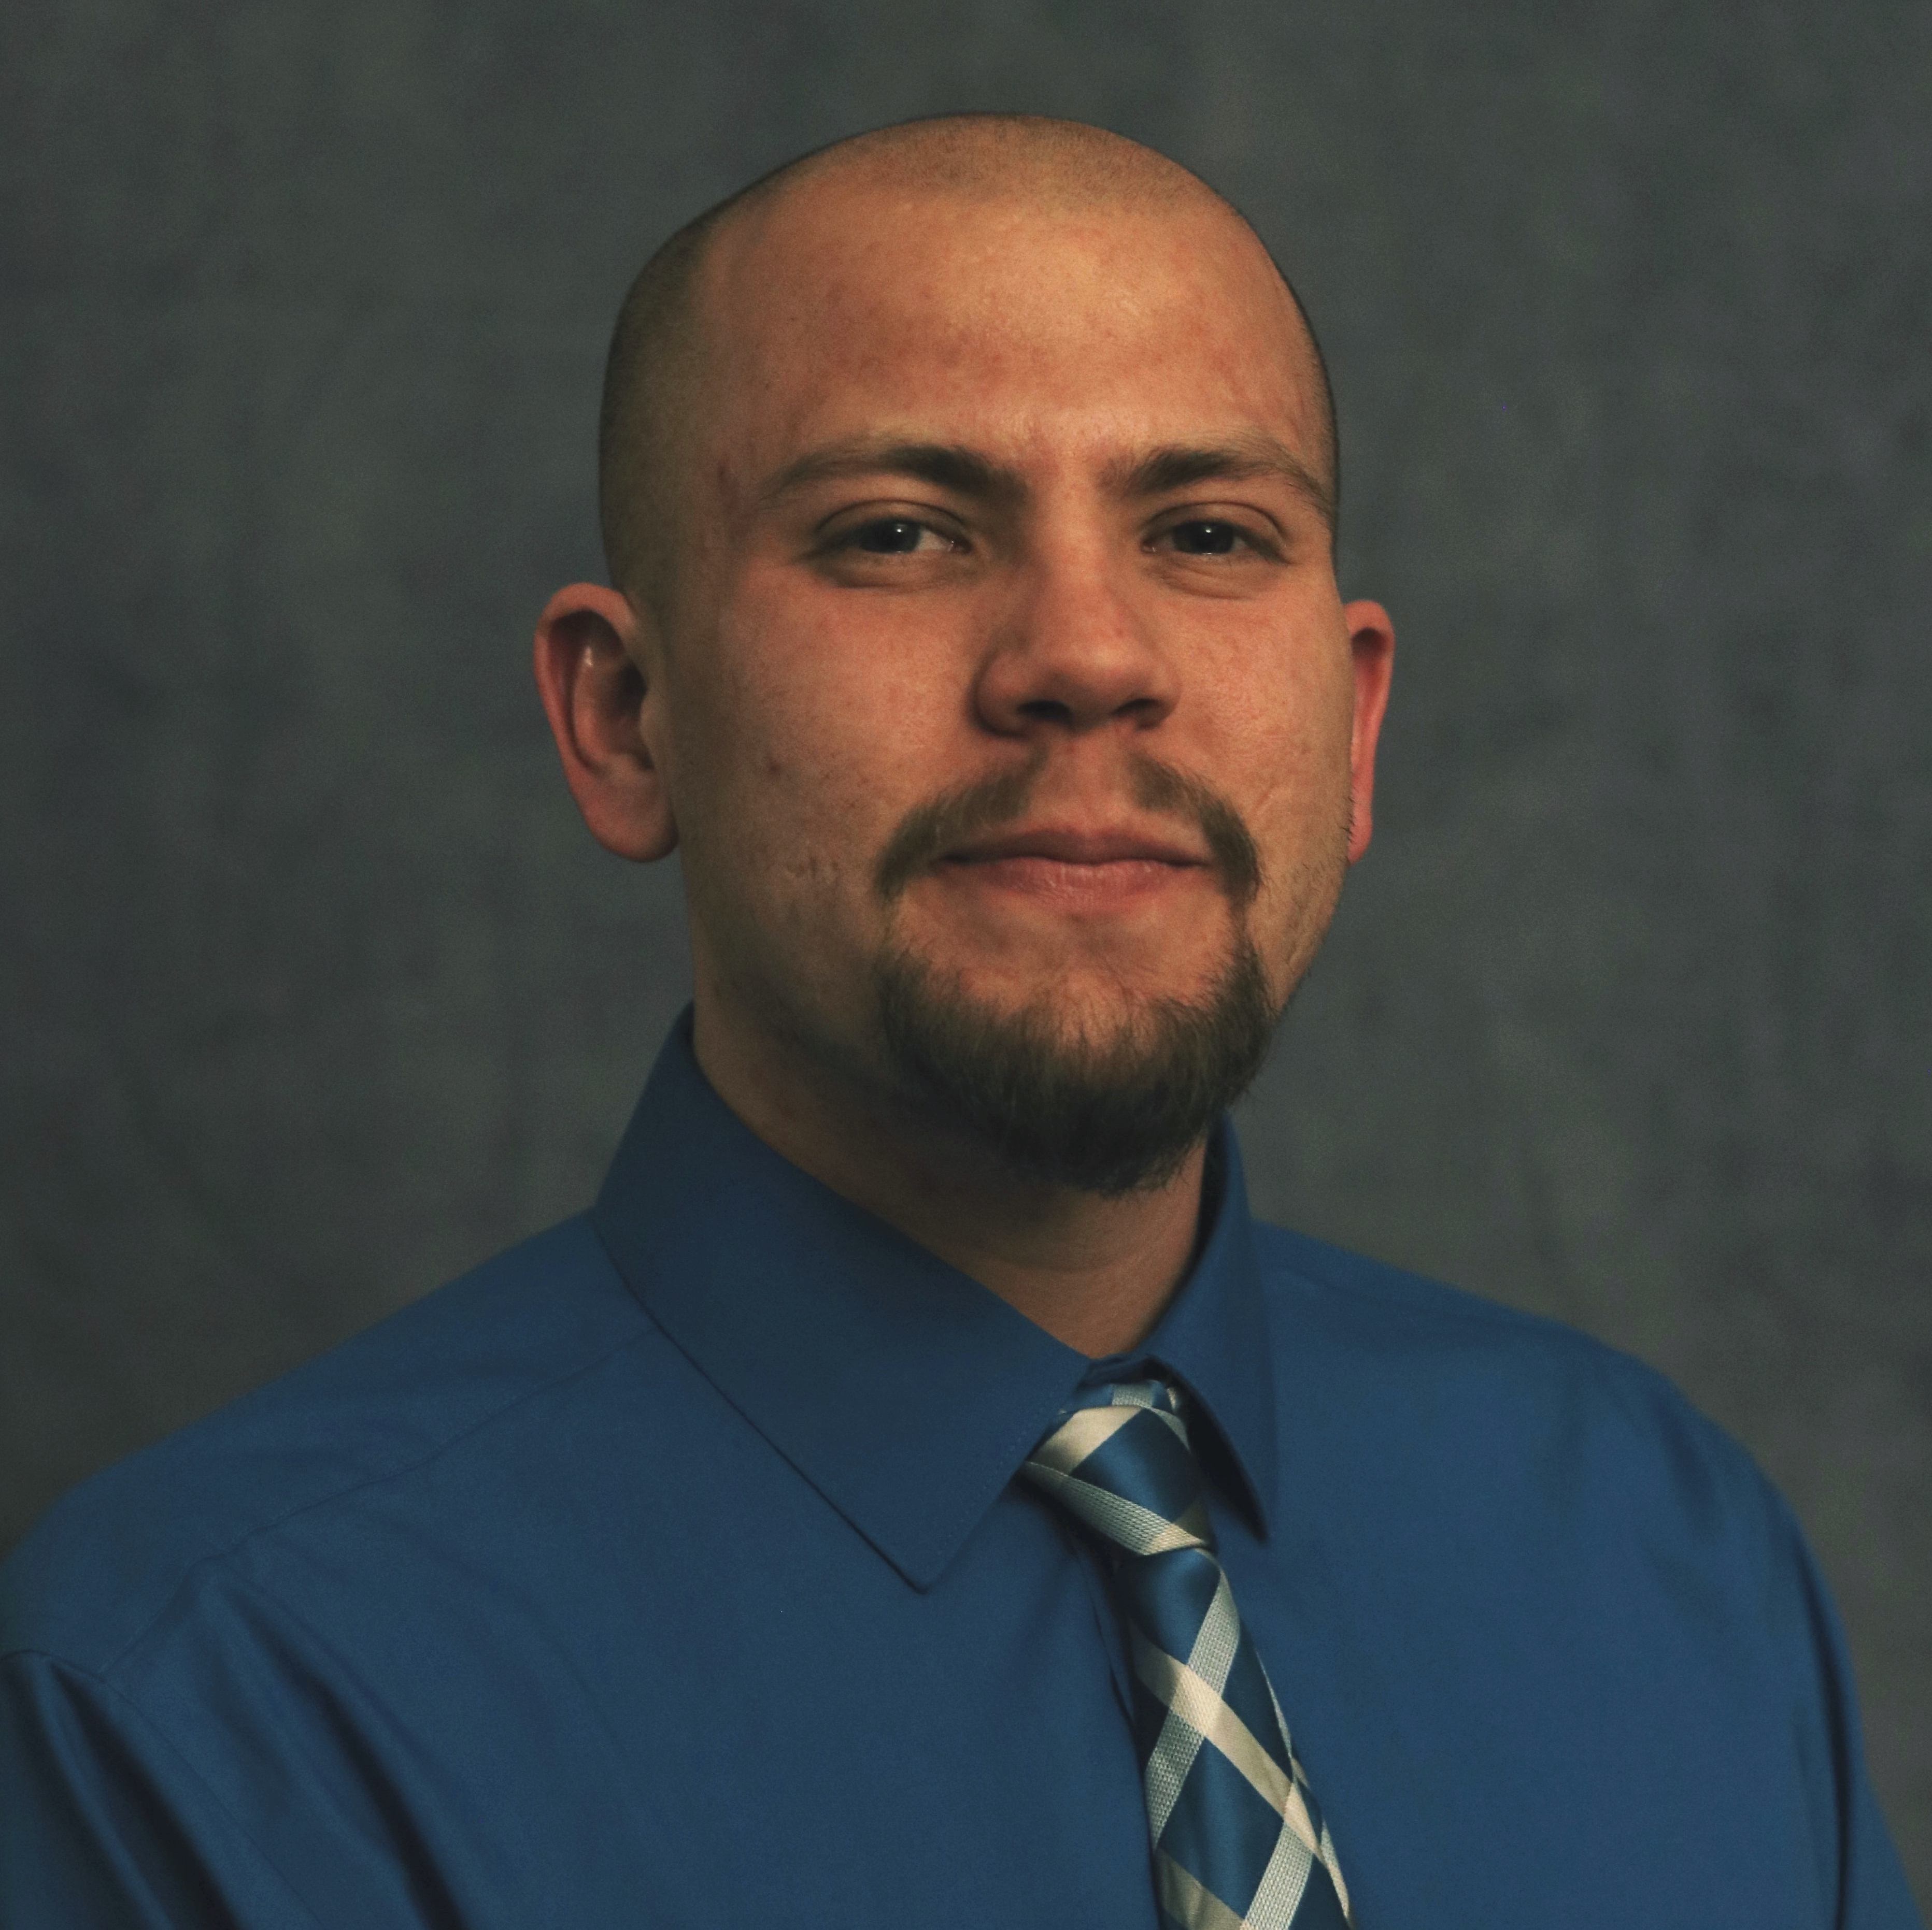
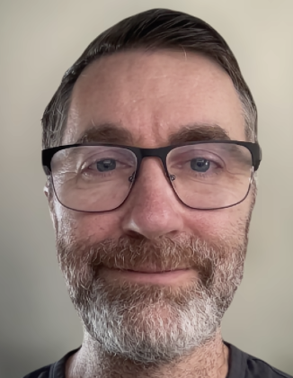


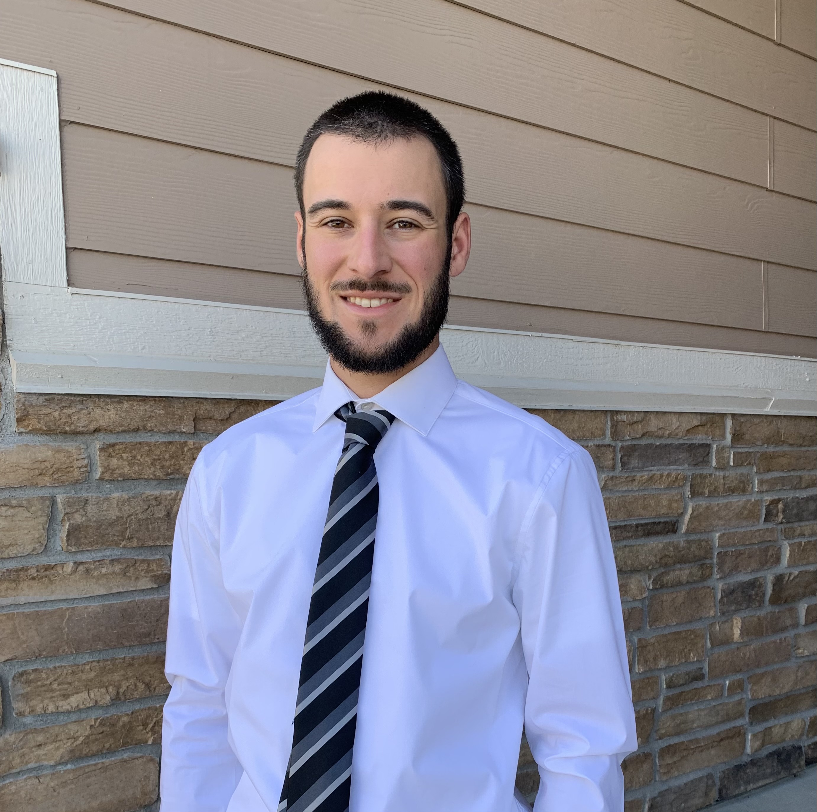


Meet the User Support Team
Layla Freeborn
Brandon Reyes
Andy Monaghan
Michael Schneider
John
Reiland
Dylan Gottlieb
Mohal Khandelwal
Ragan
Lee

Slide 4
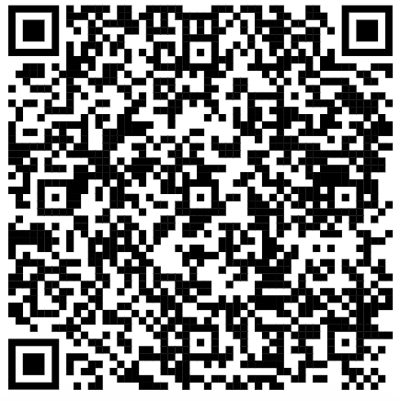
Slides https://github.com/ResearchComputing/setting_up_llms_on_curc_resources_rc_short_course

Slide 5
Session Overview
What are LLMs?
What is an LLM framework?
Accessing CURC hosted LLMs
Ollama
Transformers by Hugging Face

Slide 6
What are LLMs?
Large Language Models (LLMs)
How there are specific LLMs for certain tasks
How there are general models
Explain what open-source is and how this differs from ChatGPT etc.
It is really just a bunch on matrix multiplication and non-linear transformations
Talk about model size, how there are typically different parameter models. For general models, more parameters usually

Slide 7
What is an LLM framework?
Allows for a user-friendly way to access LLMs and utilize them
There are many frameworks, two common ones are Ollama and Transformers by Hugging Face (more on these later)
Often provides you the ability to use LLMs from the command line or within scripts

Slide 8
Accessing CURC hosted LLMs
To streamline access and reduce redundant storage of LLMs, CURC has created a shared space for common LLMs.
This is a CURC managed space, you cannot store models in this space
If you do think a model should be here, reach out to us!
All models can be accessed using the environment variable “CURC_LLM_DIR”
We currently provide models compatible with Ollama and Transformers

Slide 9
Accessing CURC hosted LLMs
Currently available models:
gpt-oss:20b
An open-source model from OpenAI (ChatGPT folks)
Requires about 14 GB of GPU memory
gemma3:12b
An open-source model from Google (a derivative of Gemini)
Requires around 8 GB of GPU memory
llama3.1:8b
An open-source model from Meta
Requires about 5 GB of GPU memory

Slide 10
Using LLMs on CURC
Before running or working with LLMs on CURC resources, please be sure that you are adhering to all CURC User Policies and CU’s policies and guidance around Artificial Intelligence outlined in the pages Artificial Intelligence at CU Boulder and Resources & Guidance.

Slide 11
Ollama
Ollama is an LLM framework maintained by Meta.
Open-source and extremely beginner friendly
Enables users to run LLMs locally and retrieve models
Ollama is slightly different from other frameworks
Easily installable models are maintained by Ollama, this means they choose what is available (you can use other models, but you need to convert them to a compatible format)
You first have to establish an Ollama server first. An Ollama server is what allows you to install, manage, and run LLMs

Slide 12
Using CURC’s Ollama install
Our modules are only available on NVIDIA GPUs, we only provide the most up-to-date version, and these versions will be updated during each planned maintenance

Slide 13
Installing Ollama
Check out the “Self-install instructions” tab of file:///Users/brre2566/CURC_work/RC-Documentation/build/html/software/llms.html#ollama

Slide 14
Running Ollama from the command line
Before proceeding with these instructions, be sure that the Ollama server is up and running. Once the Ollama server is up and running, we can interact with an LLM from the command line! Let’s run a very simple model, say the 8 billion parameter Llama 3.1 model:
Explain that Ollama needs to load the model into the GPU memory first

Slide 15
Using Ollama in a Python Script
Before proceeding with these instructions, be sure that the Ollama server is up and running and the Ollama Python API is available. To begin, we need to create a Python script that specifies the model we want to use and input we want to provide to that model. Let’s create a script called llama_query.py with the following content:
Explain that Ollama needs to load the model into the GPU memory first

Slide 16
Transformers by Hugging Face
Large Language Models (LLMs)

Slide 17

Thank you!
http://tinyurl.com/curc-survey18
Survey and feedback

Slide 18
Slides https://github.com/ResearchComputing/setting_up_llms_on_curc_resources_rc_short_course

